Slide 1
Java Servlet Programming
<Trainer Info>

Slide 2
Training agenda
Introduction
Servlet Overview and Architecture
Handling HTTP get Requests
Handling HTTP post Requests
Servlet Context

Slide 3
Introduction
Java networking capabilities
  Socket-based and packet-based communications
    Package java.net
  Remote Method Invocation (RMI)
    Package java.rmi
  Servlets and Java Server Pages (JSP)
    Request-response model
    Packages javax.servlet
        javax.servlet.http
        javax.servlet.jsp
        javax.servlet.tagext
    Form the Web tier of J2EE
Servlets are modules of Java code that run in a server application to answer client requests.

Slide 4
Servlet Overview and Architecture
Typical uses for Servlets include:
  Processing and/or storing data submitted by an HTML form.
  Providing dynamic content, e.g. returning the results of a database query to the client.
  Managing state information on top of the stateless HTTP, e.g. for an online shopping cart system which manages shopping carts for many concurrent customers and maps every request to the right customer
Servlets make use of the Java standard extension classes in the packages javax.servlet (the basic Servlet framework) and javax.servlet.http (extensions of the Servlet framework for Servlets that answer HTTP requests).
Servlet container (servlet engine)
  Server that executes a servlet

Slide 5
Servlet Overview and Architecture
Interface Servlet and the Servlet Life Cycle
Interface Servlet
  All servlets must implement this interface
  All methods of interface Servlet are invoked automatically
Servlet life cycle
  Servlet container invokes the servlet’s init method
  Servlet’s service method handles requests
  Servlet’s destroy method releases servlet resources when the servlet container terminates the servlet

Slide 6
Servlet Overview and Architecture
HttpServlet Class
Overrides method service
Two most common HTTP request types: get and post
Method doGet responds to get requests
  Retrieve the content of a URL
Method doPost responds to post requests
  Post data from an HTML form to a server-side form handler
  Browsers cache Web pages
HttpServletRequest and HttpServletResponse objects
  Created by the servlet container and passed as an argument to the servlet's service methods (doGet, doPost, etc.)
  HttpServletRequest object contains request from the client,
  HttpServletResponse object provides HTTP-specific functionality in sending a response (access HTTP headers, cookies, etc.)

Slide 7
Handling HTTP get Requests
Example: WelcomeServlet
1 // WelcomeServlet.java
2 // A simple servlet to process get requests.
3 package com.alliant.test.servlets;
4
5 import javax.servlet.*;
6 import javax.servlet.http.*;
7 import java.io.*;
8
9 public class WelcomeServlet extends HttpServlet {
10
11 // process "get" requests from clients
12 protected void doGet( HttpServletRequest request,
13 HttpServletResponse response )
14 throws ServletException, IOException
15 {
16 response.setContentType( "text/html" );
17 PrintWriter out = response.getWriter();
18
19 // send XHTML page to client
20
21 // start XHTML document
22 out.println( "<?xml version = \"1.0\"?>" );
23
24 out.println( "<!DOCTYPE html PUBLIC \"-//W3C//DTD " +
25 "XHTML 1.0 Strict//EN\" \"http://www.w3.org" +
26 "/TR/xhtml1/DTD/xhtml1-strict.dtd\">" );
27
28 out.println(
29 "<html xmlns = \"http://www.w3.org/1999/xhtml\">" );
Import the javax.servlet and javax.servlet.http packages.
WelcomeServlet that responds to a simple HTTP get request.
Extends HttpServlet to handle HTTP get requests and HTTP post requests.
Override method doGet to provide custom get request processing.
Uses the response object’s setContentType method to specify the content type of the data to be sent as the response to the client.
Uses the response object’s getWriter method to obtain a reference to the PrintWriter object that enables the servlet to send content to the client.
Create the XHTML document by writing strings with the out object’s println method.

Slide 8
Handling HTTP get Requests
Example: WelcomeServlet
30
31 // head section of document
32 out.println( "<head>" );
33 out.println( "<title>A Simple Servlet Example</title>" );
34 out.println( "</head>" );
35
36 // body section of document
37 out.println( "<body>" );
38 out.println( "<h1>Welcome to Servlets!</h1>" );
39 out.println( "</body>" );
40
41 // end XHTML document
42 out.println( "</html>" );
43 out.close(); // close stream to complete the page
44 }
45 }
WelcomeServlet that responds to a simple HTTP get request.
Closes the output stream, flushes the output buffer and sends the information to the client.

Slide 9
Handling HTTP get Requests
Example: WelcomeServlet
1 <?xml version = "1.0"?>
2 <!DOCTYPE html PUBLIC "-//W3C//DTD XHTML 1.0 Strict//EN"
3 "http://www.w3.org/TR/xhtml1/DTD/xhtml1-strict.dtd">
4
5 <!-- WelcomeServlet.html -->
6
7 <html xmlns = "http://www.w3.org/1999/xhtml">
8 <head>
9 <title>Handling an HTTP Get Request</title>
10 </head>
11
12 <body>
13 <form action = "/test/welcome1" method = "get">
14
15 <p><label>Click the button to invoke the servlet
16 <input type = "submit" value = "Get HTML Document" />
17 </label></p>
18
19 </form>
20 </body>
21 </html>
HTML document in which the form’s action invokes WelcomeServlet through the alias welcome1 specified in web.xml.

Slide 10
Handling HTTP get Requests
Setting Up the Apache Tomcat Server
Download Tomcat, latest version, from below link
  http://tomcat.apache.org
Define environment variables
  JAVA_HOME
  CATALINA_HOME
Start the Tomcat server:
  CATALINA_HOME\bin\startup.bat
Access default web applications via
  http://localhost:8080/
Shutdown the Tomcat server:
  CATALINA_HOME\bin\shutdown.bat
Further information about configuring and running Tomcat can be found on the website (http://tomcat.apache.org)

Slide 11
Handling HTTP get Requests
Deploy a Web application
Web applications
  JSPs, servlets and their supporting files
Deploying a Web application
  Directory structure
    Context root
  Web application archive file (WAR file) OR Web application folder
  Deployment descriptor
    web.xml

Slide 12
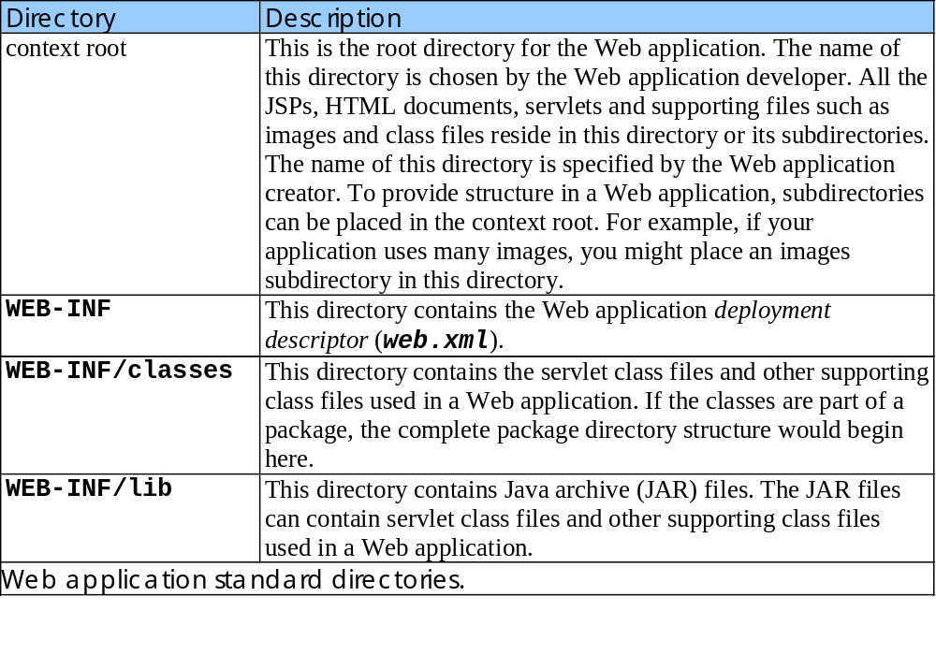
Handling HTTP get Requests
Deploy a Web application (cont.)

Slide 13
Handling HTTP get Requests
Deploy a Web application (cont.)
1 <!DOCTYPE web-app PUBLIC
2 "-//Sun Microsystems, Inc.//DTD Web Application 2.2//EN"
3 "http://java.sun.com/j2ee/dtds/web-app_2_2.dtd">
4
5 <web-app>
6
7 <!-- General description of your Web application -->
8 <display-name>
9 Sample
10 Servlet Examples
11 </display-name>
12
13 <description>
14 This is the Web application in which we
15 demonstrate our JSP and Servlet examples.
16 </description>
17
18 <!-- Servlet definitions -->
19 <servlet>
20 <servlet-name>welcome1</servlet-name>
21
22 <description>
23 A simple servlet that handles an HTTP get request.
24 </description>
25
26 <servlet-class>
27 com.alliant.test.servlets.WelcomeServlet
28 </servlet-class>
29 </servlet>
30
Deployment descriptor (web.xml) for the Web application.
Element web-app defines the configuration of each servlet in the Web application and the servlet mapping for each servlet.
Element display-name specifies a name that can be displayed to the administrator of the server on which the Web application is installed.
Element description specifies a description of the Web application that might be displayed to the administrator of the server.
Element servlet describes a servlet.
Element servlet-name is the name for the servlet.
Element description specifies a description for this particular servlet.
Element servlet-class specifies compiled servlet’s fully qualified class name.

Slide 14
Handling HTTP get Requests
Deploy a Web application (cont.)
31 <!-- Servlet mappings -->
32 <servlet-mapping>
33 <servlet-name>welcome1</servlet-name>
34 <url-pattern>/welcome1</url-pattern>
35 </servlet-mapping>
36
37 </web-app>
Deployment descriptor (web.xml) for the Web application.
Element servlet-mapping specifies servlet-name and url-pattern elements.
Invoke WelcomeServlet example
  /test/welcome1
    /test specifies the context root
    /welcome1 specifies the URL pattern
Web application directory, file structure
  test
    servlets\WelcomeServlet.html
    WEB-INF
      web.xml
      classes\com\test\servlets
        WelcomeServlet.class
URL pattern formats
  Exact match
    /test/welcome1
  Path mappings
    /test/example/*
  Extension mappings
    *.jsp
  Default servlet
    /test/example/

Slide 15
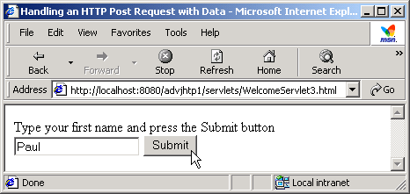
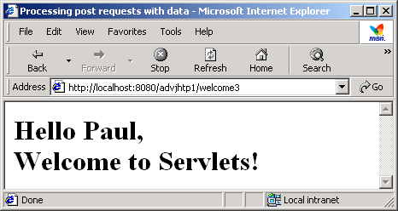
Handling HTTP post Requests
HTTP post request
  Post data from an HTML form to a server-side form handler
  Browsers cache Web pages
Practices time:
  Let’s try to see differences between HTTP post and HTTP get requests
  Use HTTPServletRequest’s getParameter method() to get param value

Slide 16
Servlet Context
Defined by an object of ServletContext type.
Defines a servlet’s view of the web application within which the servlet is running.
Allows a servlet to access resources available to it.
Using such an object, a servlet can log events, obtain URL references to resources, and set and store attributes that other servlets in the context can use.

Slide 17
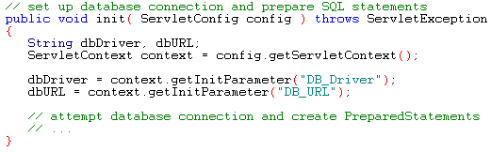
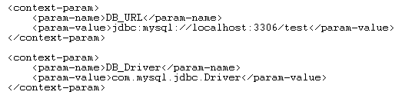
Servlet Context
Sample
We can change the init() method of the SurveyServlet as below:
Then we need to amend the web.xml file to specify the initial context parameters:

Slide 18
Servlet Context
Servlet Lifecycle Events
From Java Servlet 2.3
New events framework
More global control than any one servlet or JSP can provide
Support event notifications for state changes in ServletContext and HttpSession objects
Scope
  ServletContext: manage state held at a VM level for the application
  HttpSession: manage state or resources associated with a series of requests from the same user/session
  In distributed containers, one listener instance /deployment descriptor declaration / java VM

Slide 19
Servlet Context
ServletContext and HttpSession
Interesting things on the servlet contexts:
  Manage
  Startup/shutdown
  Attribute changes
Interesting events on HTTP sessions:
  Creation and invalidation
  Changes in attributes
  Migration across distributed containers
Attribute changes to both objects may occur concurrently
  No synchronization support in container
  Listener classes need to support data integrity

Slide 20
Servlet Context
Java Servlet 2.3 API - Listening Interfaces
ServletContextListener
  contextInitialized/Destroyed(ServletContextEvent)
ServletContextAttributeListener
  attributeAdded/Removed/Replaced(ServletContextAttributeEvent)
HttpSessionListener
  sessionCreated/Destroyed(HttpSessionEvent)
HttpSessionAttributeListener
  attributedAdded/Removed/Replaced(HttpSessionBindingEvent)

Slide 21
Servlet Context
Basic Steps for Implementing Event Listeners
Create a new class that implements the appropriate interface
Override the methods needed to respond to the events of interest
Obtain access to the important Web application objects
  Servlet context
  Servlet context attribute, its name and value
  Session, session attribute name and value
Use these objects
  e.g. Servlet context: getInitParameter(), setAttribute() and getAttribute()
Declare the listener: configure listener, listener-class in web.xml
Provide any needed initialization parameters

Slide 22
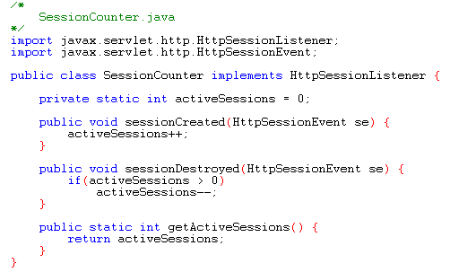
Servlet Context
Example – A Session Counter Listener
Implement the session counter:

Slide 23
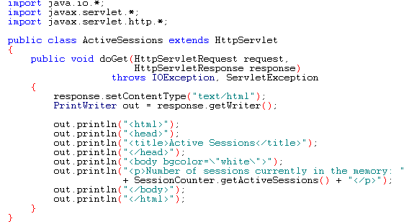
Servlet Context
Example – A Session Counter Listener (cont.)
Show session counter status:

Slide 24
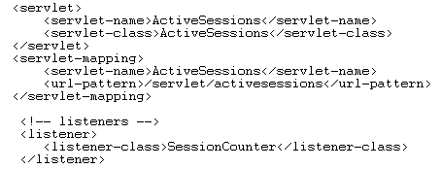
Servlet Context
Example – A Session Counter Listener (cont.)
Configure the web.xml

Slide 25
Q & A

